Slide 1
Programming Study Artificial Neural Network v2
Sungwoo Nam
2018.1.18

Slide 2
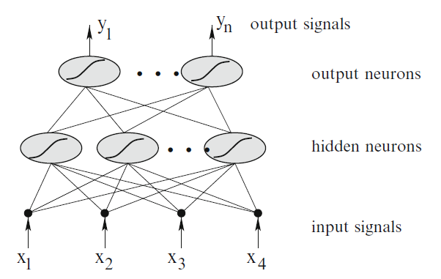
Artificial Neural Network
bias
bias
An Introduction to Machine Learning – Miroslav Kubat, Springer

Slide 3
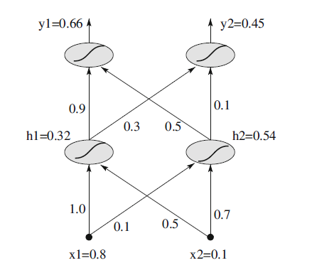

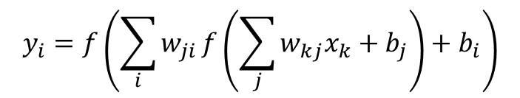
Forward Propagation
$$y_{i}=f\left(\sum_{i}{w_{ji}}f\left(\sum_{j}{w_{kj}x_{k}}+b_{j}\right)+b_{i}\right)$$

Slide 4
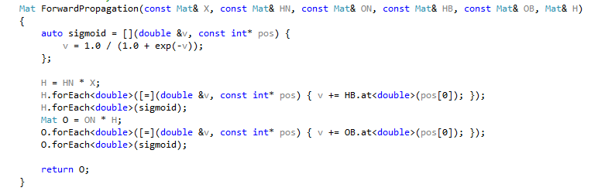

Forward Propagation In Code

Slide 5
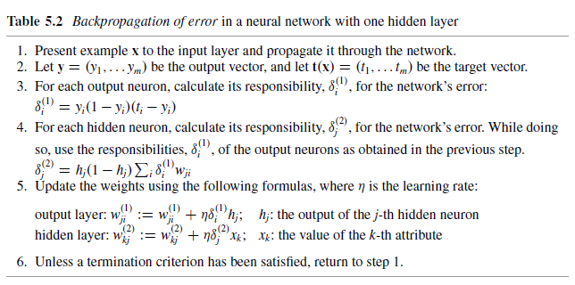
Backward Propagation

Slide 6
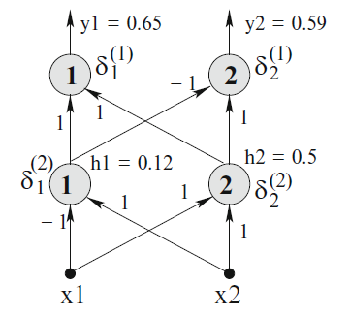



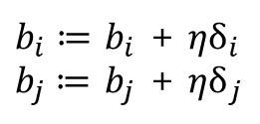
Backward Propagation
$b_{i}≔$ $b_{i}$ + ${ηδ}_{i}$
$b_{j}≔$ $b_{j}$ + ${ηδ}_{j}$

Slide 7
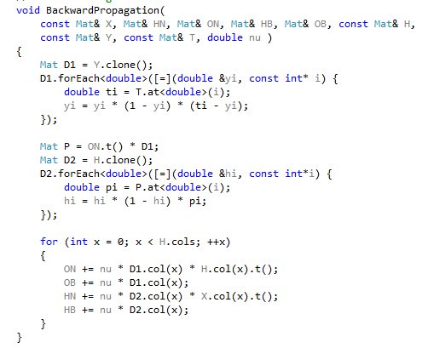
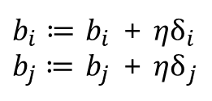
Backward Propagation In Code
$b_{i}≔$ $b_{i}$ + ${ηδ}_{i}$
$b_{j}≔$ $b_{j}$ + ${ηδ}_{j}$

Slide 8
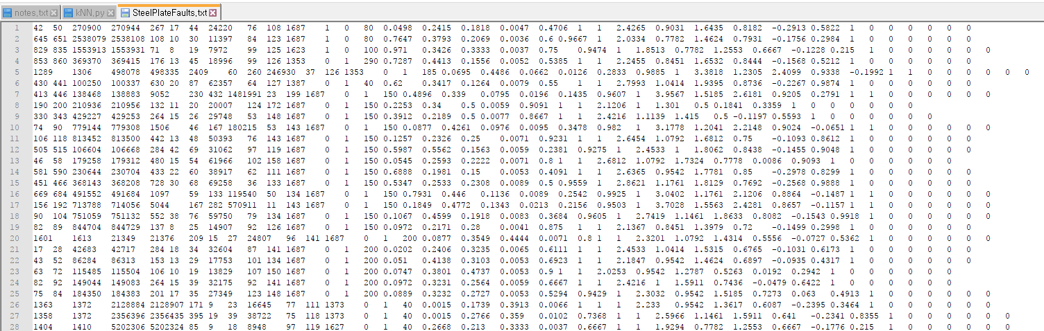
Training Data
http://archive.ics.uci.edu/ml/datasets/steel+plates+faults

Slide 9
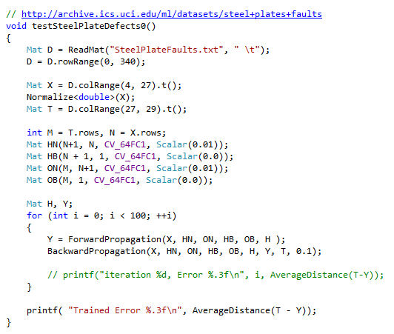
Training
iteration 0, Error 0.708
iteration 1, Error 0.748
iteration 2, Error 0.814
iteration 3, Error 0.872
iteration 4, Error 0.722
iteration 5, Error 0.882
iteration 6, Error 0.672
iteration 7, Error 0.705
iteration 8, Error 0.635
iteration 9, Error 0.669
…
iteration 95, Error 0.086
iteration 96, Error 0.084
iteration 97, Error 0.078
iteration 98, Error 0.095
iteration 99, Error 0.090
Trained Error 0.090

